Slide 1
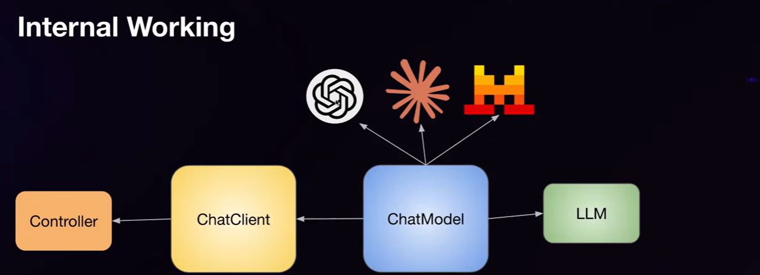
Spring Boot AI
spring boot AI mainly containing , ChatClient , ChatMaodel which can used by GPT-4 or we can use Local Ollama Model also.
Chat model can be different types . All chat model are using own code and classes for Java code .

